Slide 1
Hotel Booking Cancellations
Cynthia Lee, Andrea Lee, Karen Huang

Slide 2
PREDICTING CANCELLATIONS
Can we predict whether a Hotel Booking will be canceled?
Cancellation may be caused by several reasons
What room was booked
Whether a deposit was placed
Time the booking was for
etc.
Notes:
Data set has various features -> cleaning the data

Slide 3
OUR PROCESS
1.
Data Cleaning
2.
EDA
3.
Modeling

Slide 4
1.
DATA
CLEANING
Null and undefined values; dropping, adding, and mapping features.

Slide 5
NULL VALUES
agent and company
Indicates booking was made without one
Set to 0
children
Indicates booking was made without children
Set to 0
country
488 null data points (~0.4% of the data)
Dropped the data points

Slide 6
‘Undefined’ VALUES
distribution_channel
5 data points
market_segment
2 data points
We decided to drop these data points for both features.

Slide 7
‘Undefined’ VALUES
meal
1165 data points
“Undefined” and “SC” to both mean no meal package (defined in the Data description)
We replaced all the “Undefined” values with “SC”.

Slide 8
DROPPED FEATURES
reservation_statis
Very similar to is_canceled
No Shows are labeled as canceled in is_canceled
is_canceled is our target feature
reservation_status_date
No date to compare to reservation_status_date with
Notes:
Very similar to is_canceled = In **reservation_status**, no shows are labeled as canceled in **is_canceled** with a value of 1. **is_canceled** is our models' target feature.
Reservation_status_date - no analysis

Slide 9
ADDED FEATURES
group_size
Sum of adults, children, babies
Possible Error : group_size of 0
No one is staying at the hotel booking
Dropped data points with a group_size of 0.
Notes:
We combined the total number of people into a new column called **group_size**. This column adds the number of babies, adults and children.
We decided to check for a possible error - having a group size of 0 would mean that there would be no people staying at the hotel.
We decided to remove rows with a group size of 0 because we thought it might be an error to have no guests booking a hotel.

Slide 10
ADDED FEATURES
room_changed
Indicates if a booking’s assigned_room_type changed from their reserved_room_type.
True/False values
Notes:
We feel that it may be more likely for someone to cancel their booking if their room changed from what they wanted. True or false values.
The feature **room_changed** has either a 0 and 1 value. 0 indicates that the room did not change and 1 indicates that the room did change. We think this will be a useful feature for us to analyze.
Room type could change for the better - do not know how to rank rooms.

Slide 11
MAPPING FEATURES
Changed features with string values to integers.
arrival_date_month
Assigned months their number values
meal
Ranked based on more included meals
deposit_type
Ranked based on financial attachment
Notes:
We changed the **arrival_date_month** to ordinal number values.
We changed the **meal** to ordinal values ranked based on increasing values with more included meals. - define values
We changed the **deposit_type** to ordinal values ranked based on increasing values with more financial attachment. - define values

Slide 12
2.
EXPLORATORY
DATA ANALYSIS
Splitting the data, answering questions, correlation heatmap.

Slide 13
SPLITTING THE DATA
Over 100,000 data entries
We split the data into :
75% : Training Data
25% : Testing Data
Notes:
Next, we split the data. We don't want to see the testing data before our model is built, so we will do this before doing any data analysis.

Slide 14
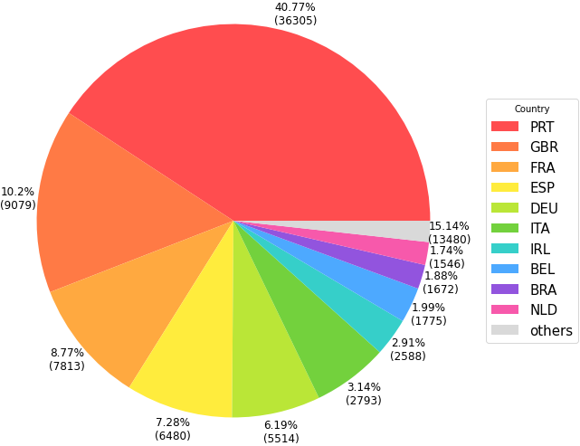
Q1. Which country saw the most hotel bookings according to the data?
Top 10 Countries by Number of Bookings
Notes:
We decided to make a pie chart with the number of bookings per country. Since there were so many countries, we decided to limit the chart to the top 10 countries by most number of bookings and combine the rest of them into one slice called "others". Using this, we found that the country with the most listings is **Portugal**.

Slide 15
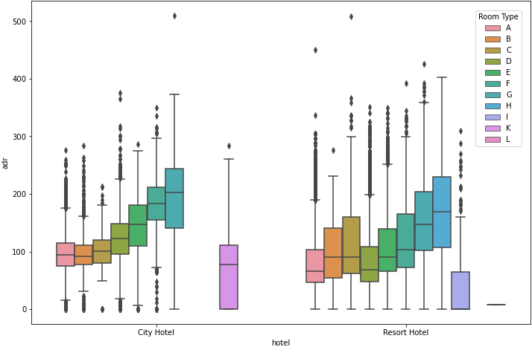
Q2. What is the distribution like for both hotels with respect to price of a room per night?
Average Room Price per Night
Notes:
We chose to use a box plot to show the distributions and decided to split it by **room_type**. There were one data point that was an outlier with an extreme adr value of around 5000 and we removed it so that the box plots would be reasonably scaled.
On average, the City Hotel is pricier for each room type. Generally, the spread of prices for the Resort Hotel is larger than the City Hotel.

Slide 16
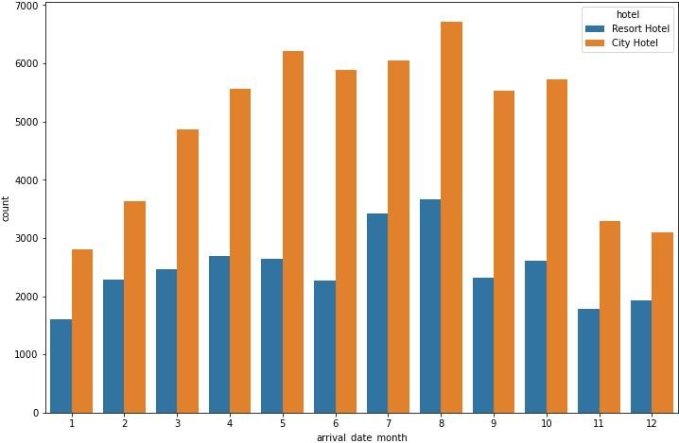
Q3. Which months are the most busy for both hotels?
Bookings per Month
Notes:
Question 3: Which months are the most busy for both hotels?
We used a count plot to display the bookings per month and split it by the hotel the booking was for.
The months that are the most busy for both hotels seems to be May, July, August. August has the most for both hotels. The least popular months are November, December, January.
There are more bookings for the City Hotel than the Resort Hotel.

Slide 17
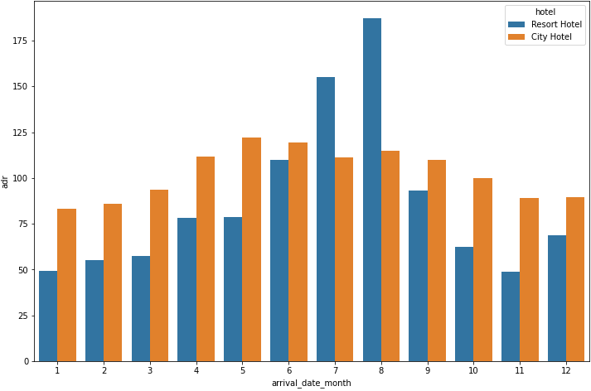
Q3. Which months see the most expensive per night costs?
ADR per Month
Notes:
Question 3: Which months see the most expensive per night costs?
We made a bar plot of the mean ADR for each month and separated the data based on hotel.
For the Resort Hotel, June, July, August have a greater average per night cost than other months, August being the greatest. The average per night cost is the lowest during November. For the City Hotel, each month has similar average per night costs. The Resort Hotel has a larger range of average prices than the City Hotel.

Slide 18
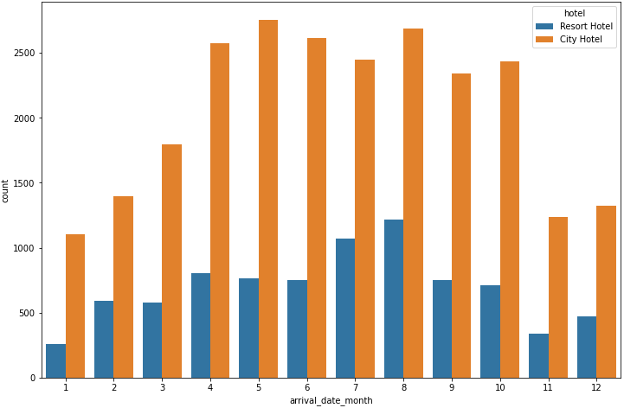
Q4. Which months see the most cancellations for both hotels?
Cancellations per Month
Notes:
We used a count plot to display the cancellations per month and split it by the hotel the booking was for.
For the City Hotel, April, May, June, August have more cancellations than other months. The months of November, January have the lowest number of cancellations per month. The shape of the cancellations per month is similar to bookings per month.
For the Resort Hotel, July, August have more cancellations than other months. The shape of the cancellations per month is similar to bookings per month.
The City Hotel has more cancellations per month than the Resort Hotel. However, the City Hotel has more total hotel bookings per month.November. For the City Hotel, each month has similar average per night costs. The Resort Hotel has a larger range of average prices than the City Hotel.

Slide 19
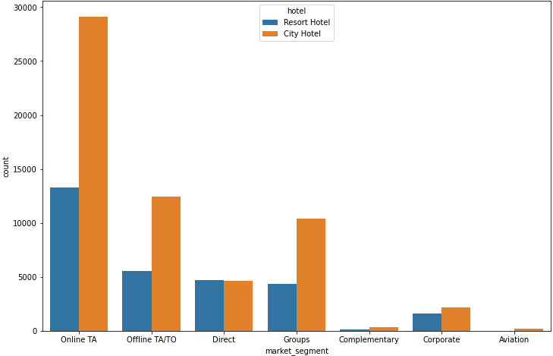
Q5. Examine distributions of bookings vs market segment
Bookings per Market Segment
Notes:
We used a count plot to display the cancellations per month and split it by the hotel the booking was for.

Slide 20
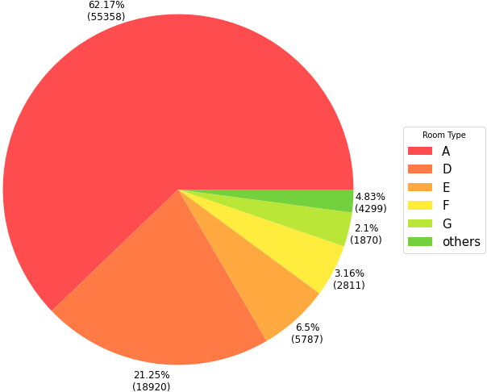
Q6. Which room type was most commonly booked?
Top 5 Room Types by Number of Bookings
Notes:
Question 6: Which room type was most commonly booked?
We decided to use a pie chart to highlight the differences between the top 5 most commonly booked rooms. We grouped the rest of the room types under "others".
Room Type A has the most bookings and by a large margin compared to the rest of the room types. Room Type A makes up over half of the number of bookings. Room type D has the second largest amount of bookings. The remaining top room types, E, F, and G, make up around the same percentage of bookings.

Slide 21
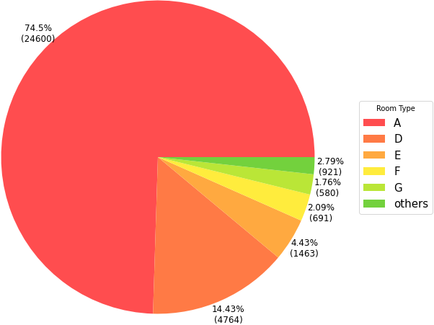
Q6. Which room type was most commonly cancelled?
Top 5 Room Types by Number of Cancellations
Notes:
Question 6: Most commonly cancelled?
We also decided to use a pie chart for the top 5 most canceled rooms. We grouped the rest of the room types under "others".
Room Type A is the most canceled room type. Room Type A makes up around 3/4 of the cancellations. Similarly to the most commonly booked, room types D, E, F, and G are the rest of the most canceled rooms. Room type D number of cancellations also is significantly greater than remaining top canceled room types, E, F, and G.
We noticed that the answer to both these questions were the same rooms in the same order, even though the percentages were not exactly the same.

Slide 22
Q6.
Top 5 Room Types by Number of Bookings
Top 5 Room Types by Number of Cancellations
Notes:
Question 6: Most commonly cancelled?
We also decided to use a pie chart for the top 5 most canceled rooms. We grouped the rest of the room types under "others".
Room Type A is the most canceled room type. Room Type A makes up around 3/4 of the cancellations. Similarly to the most commonly booked, room types D, E, F, and G are the rest of the most canceled rooms. Room type D number of cancellations also is significantly greater than remaining top canceled room types, E, F, and G.
We noticed that the answer to both these questions were the same rooms in the same order, even though the percentages were not exactly the same.

Slide 23
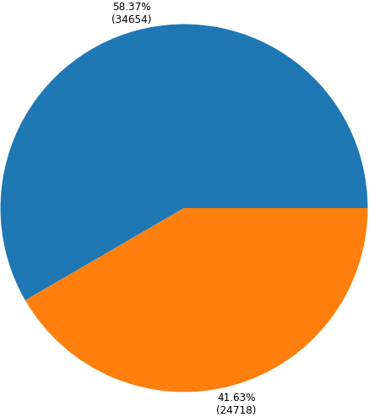
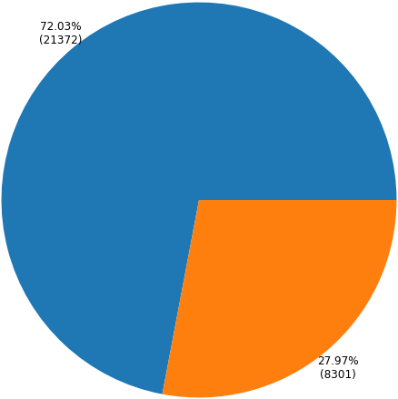
Q7. What percentage of the data recorded cancellations for each hotel?
Resort Hotel Cancellations
City Hotel Cancellations
Is Canceled
False
True
Notes:
We made pie charts for the bookings of both hotels and had 2 wedges in each, one for canceled bookings and the other for the rest.
For the resort hotel, 27.97% of the bookings were canceled. For the city hotel, 41.63% of the bookings were canceled, which is much higher than the resort hotel's percentage.
We noticed that the answer to both these questions were the same rooms in the same order, even though the percentages were not exactly the same.

Slide 24
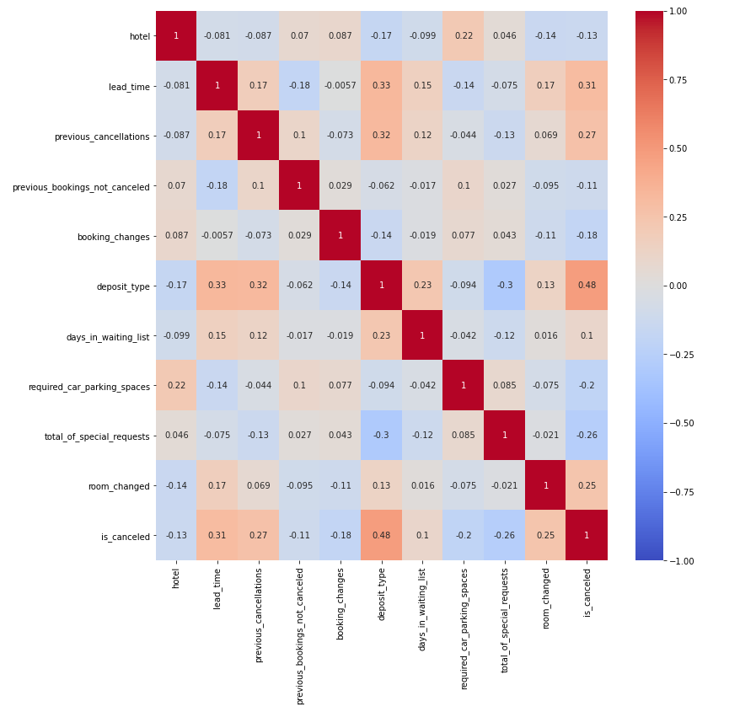
Spearman Correlation Heatmap
Features with correlation of 0.1 or higher :
hotel
lead_time
previous_cancellations
previous_bookings_not_canceled
booking_changes
deposit_type
days_in_waiting_list
required_car_parking_spaces
total_of_special_requests
room_changed
Removed Features :
country
market_segment
distribution_channel
reserved_room_type
assigned_room_type
customer_type
Notes:
We decided to make a heatmap with the data to see which features were most correlated to our data. We thought this would help us cut down the number of features when building our model since this dataset had so many different features.
Since some features were not easily mappable, we decided to drop them for the heatmap. Those features were:
- country
- market_segment
- distribution_channel
- reserved_room_type
- assigned_room_type
- customer_type
We also used Spearman correlation since Pearson works only for linear data, which some of this data might not be, and since Pearson is more influenced by outliers, which we believed this big a dataset would most likely have.
We decided to pick the features that had an absolute value of correlation with **is_canceled** as 0.1 or higher, since this dataset is quite large. These features are:
- hotel
- lead_time
- previous_cancellations
- previous_bookings_not_canceled
- booking_changes
- deposit_type
- days_in_waiting_list
- required_car_parking_spaces
- total_of_special_requests
- room_changed
We decided to make another heatmap with just the correlated features mentioned above. If two of those features are correlated with each other, we would pick one to drop before we build our models.
Nothing seems to be highly correlated so we decided to keep these features.

Slide 25
3.
MODELING
& EVALUATION
Logistic Regression, Decision Tree Classifier, K-Neighbors & Precision, Recall, F-Score.

Slide 26
MODEL 1 :
LOGISTIC REGRESSION
Precision
Without CV :
0.825
10-fold CV average :
0.825
Recall
Without CV :
0.693
10-fold CV average :
0.691
F - Score
Without CV :
0.702
10-fold CV average :
0.700
Logistic Regression Cross-Validation :
Precision : [0.838, 0.822, 0.828, 0.829, 0.822, 0.828, 0.826, 0.827, 0.811, 0.820]
Recall : [0.702, 0.689, 0.692, 0.698, 0.691, 0.689, 0.689, 0.697, 0.679, 0.687]
F-score : [0.713, 0.697, 0.701, 0.708, 0.700, 0.698, 0.698, 0.707, 0.686, 0.695 ]
Notes:
For our first model, we decided to use Logistic Regression.
Without cross-validation, the model had an f-score of around 0.702. With cross-validation, the average f-score across a 10-fold cross-validation was 0.700. These models performed similarly. Their precisions and accuracies were also similar values. In this case, cross-validation did not improve the model significantly.

Slide 27
MODEL 2 :
DECISION TREE CLASSIFIER
Precision
Without CV :
0.784
10-fold CV average :
0.781
Recall
Without CV :
0.751
10-fold CV average :
0.746
F - Score
Without CV :
0.760
10-fold CV average :
0.756
Decision Tree Classifier Cross-Validation :
Precision : [0.784, 0.781, 0.779, 0.784, 0.774, 0.786, 0.783, 0.787, 0.772, 0.778]
Recall : [0.747, 0.746, 0.746, 0.749, 0.741, 0.748, 0.748, 0.750, 0.734, 0.745]
F-score : [0.758, 0.756, 0.756, 0.759, 0.750, 0.759, 0.759, 0.761, 0.744, 0.755]
Notes:
For our second model, we decided to use the Decision Tree Classifier.
Without cross-validation, the model had an f-score of around 0.760. With cross-validation, the average f-score across a 10-fold cross-validation was around 0.756. These models performed similarly. Their precisions and accuracies were also similar values. In this case, cross-validation did not improve the model significantly.

Slide 28
MODEL 3 :
K - NEAREST NEIGHBORS
Precision
Without CV :
0.767
10-fold CV average :
0.759
Recall
Without CV :
0.744
10-fold CV average :
0.738
F - Score
Without CV :
0.752
10-fold CV average :
0.745
K - Nearest Neighbor Cross-Validation :
Precision : [0.7601, 0.756, 0.763, 0.763, 0.762, 0.759, 0.764, 0.756, 0.753, 0.755]
Recall : [0.741, 0.734, 0.743, 0.741, 0.741, 0.737, 0.744, 0.738, 0.730, 0.733]
F-score : [0.748, 0.741, 0.745 0.748, 0.748, 0.745, 0.751, 0.745, 0.737, 0.740]
Notes:
For our third model, we decided to use K Neighbors.
Without cross-validation, the model had an f-score of around 0.752. With cross-validation, the average f-score across a 10-fold cross-validation was around 0.745. These models performed similarly. Their precisions and accuracies were also similar values. In this case, cross-validation did not improve the model significantly.

Slide 29
THANKS!
Any questions?

